Slide 1
HTTP

Slide 2
HTTP Features
Connectionless
Media Independent
Stateless

Slide 3
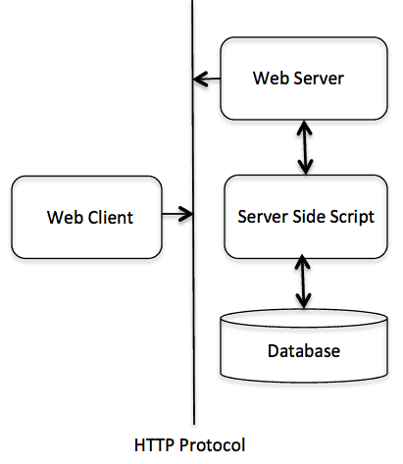
HTTP Architecture

Slide 4
HTTP Methods
GET
HEAD
POST
PUT
DELETE
CONNECT
OPTION
TRACE

Slide 5
HTTP Status Codes
1xx: Informational
2xx: Successful
3xx: Redirection
4xx: Client Error
5xx: Server Error

